Slide 1
Hierarchical Attention Based Recurrent Neural Network Framework For Mobile MOBA Game Recommender Systems
Group No - 25
Md. Sifat Kamal - 20101231
ST - Abid Hossain
RA - Sania Azhmee Bhuiyan

Slide 2
Why this Paper?
This paper is based in Hierarchical Recurrent Neural Network (HRNN) that is similar concept to our project
There are enough information that can assist us to do our project

Slide 3
Introduction
Recommendation systems are widely used in many fields to provide better experience like: e-commerce sites, news recommendation etc.
The paper has worked with the recommendation system with the player’s interest for providing recommendation of game items to purchase.
The main challenge is to understanding the interest of the player more precisely since the interest of a player changes over time to time constantly
For overcoming the author has explored the behaviour of the players behavior dynamically to understanding the interest of the player
For the system RNN models had used for getting proper accuracy since it provides 2% higher accuracy compared to DNN models
The research has done with the real game data of King of Glory

Slide 4
Background
The first step of a recommendation system is to understanding the scene and build the basic mathematical model for the system that will have the ability to determining the learning method along with sample structure
Here the basic RNN model completes the extension in recommendation scenes. But the basic model is not capable of fixing all the challenges that needs to be fixed in the system
In Hierarchical attention-based LSTM, it’s combined with attention mechanism that is enough feasible to provide solve of interpretability problem

Slide 5
Dataset
For evaluating the performance of the framework the authors of the paper has used the data of King of Glory
The data were from the logs of week from June 10th to 16th, 2017
For every match the authors have extracted eleven behaviours for the recommendation
In the end authors had generated approximately 810,000 samples where 730,000 samples were assigned for training and 80,000 samples were assigned for testing

Slide 6
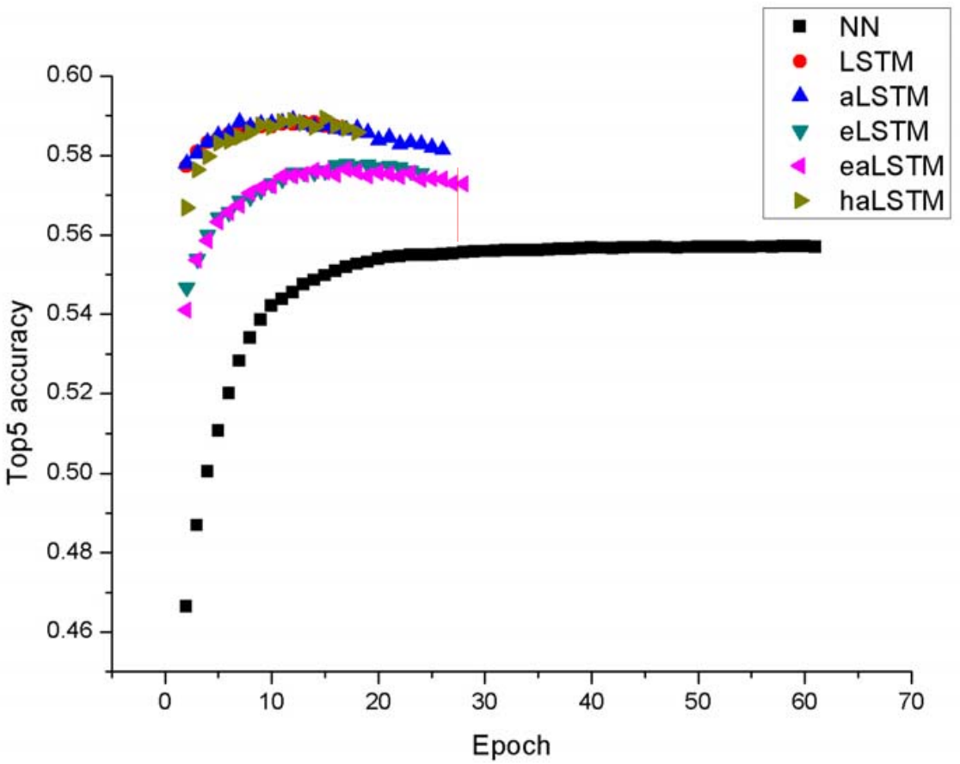
Results
Top 5 accuracy:
NN models obtain worst performance for not considering historical behaviour of a player.
LSTM, aLSTM and haLSTM got highest accuracy for utilizing temporal info of historical behaviour of a player.
eLSTM and eaLSTM have lower accuracy than the best model for embedding dimension d value.
Fig. 1. Top-5 accuracy for different models

Slide 7
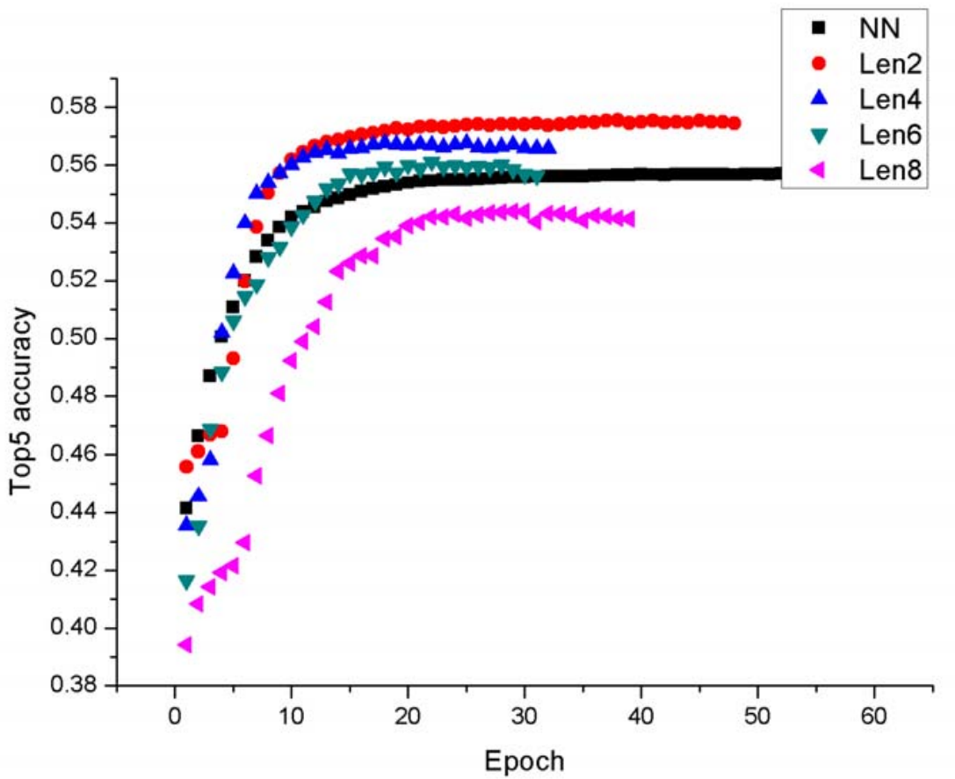
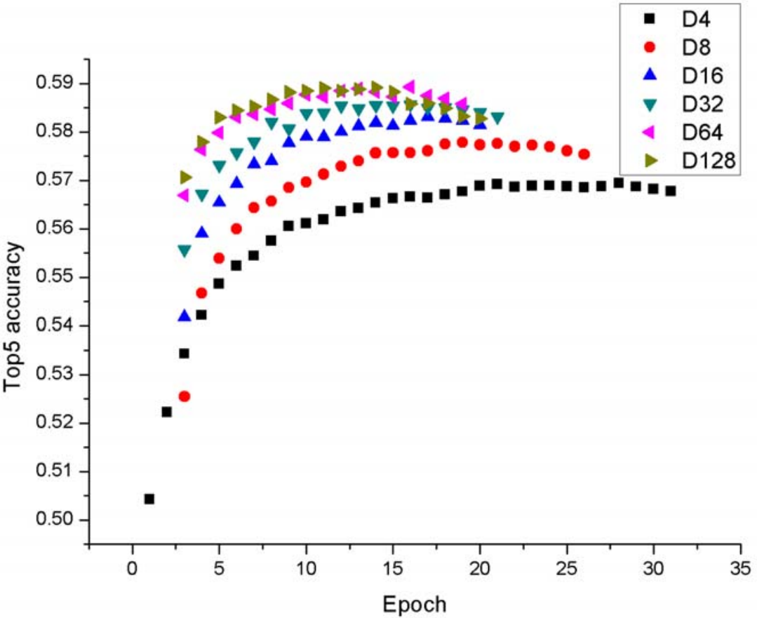
Results
Effect of the sequence lenght:
When length is 1, the model uses only the last match for the input
When length is 2, haLSTM gets the highest accuracy
As the length increased to 8 the accuracy becomes lower in the NN model
Effect of the embedding method:
LSTM models with an embedding layer have lower accuracy
high dimension embedding vector achieves better accuracy
Fig. 2. Top-5 accuracy with fixed length
Fig. 3. Top-5 accuracy with variable dimensions

Slide 8
Future scope of improvement
Combining multiple sessions
Utilize the effect of historical behavior

Slide 9
Conclusion
The problem is player’s purchase preference changing over game experience & the recommendation system can not provide proper recommendations and the paper is solving this issue
The skeleton of the framework brings LSTM to model the long match sequence
Hierarchical attention includes match attention and event attention.
match attention: measure the importance of match in a sequence
event attention: measure the importance of events in a match
The experiment demonstrates the effectiveness of attention

